Slide 1

Life Of Journey
Presented By :
NITESH GHUBDE FSWD_03

Slide 2
PROBLEM STATEMENT
The purpose of websites is fact that internet users are increasing today.Today One of the main purposes of the website is for a user can directly come on my website visit the tour places, And plan where want to go to which destination.
destination-based comprehensive investigations into tourist behaviour need to be further conducted.
which will help to come to an overall understanding of tourist behaviour in relation to development of tourism resources.
Checking on which destination is more popular how’s is rating for this .

Slide 3
Market research and the need to have this project
Due to this project, many things became easy because people can easily find where to visit the tourist place.
No need to search on google they come directly to my website and check here where to go.
You can come here and see which place is famous and get complete information.
You can see the rating of this place, how many people have seen it.
It's fully responsive, you can easily access it on mobile.

Slide 4
FEATURES OF PROJECT
Sign In , Sign Up and Sign Out
Add Tour,Update Tour and Delete Tour
Show List Of Tour
Show Single Tour
Search Bar
Like
Get Tour By Tag
Pagination
Comment On Tour

Slide 5
TECHNOLOGY USE
Front End :
React JS
Redux-ToolKit
Material Design Bootstrap (MDB)
Back End :
NodeJs
ExpressJS
MongoDB
Mongoose

Slide 6
ER-DIAGRAM
Id
Name
Title
Description
Name
UserId
One To Many
User
Tour
Email
Password
Img-File
Date
Tags
Like
Note :User Can Create Many Tours

Slide 7
PROJECT SNIPS

Slide 8

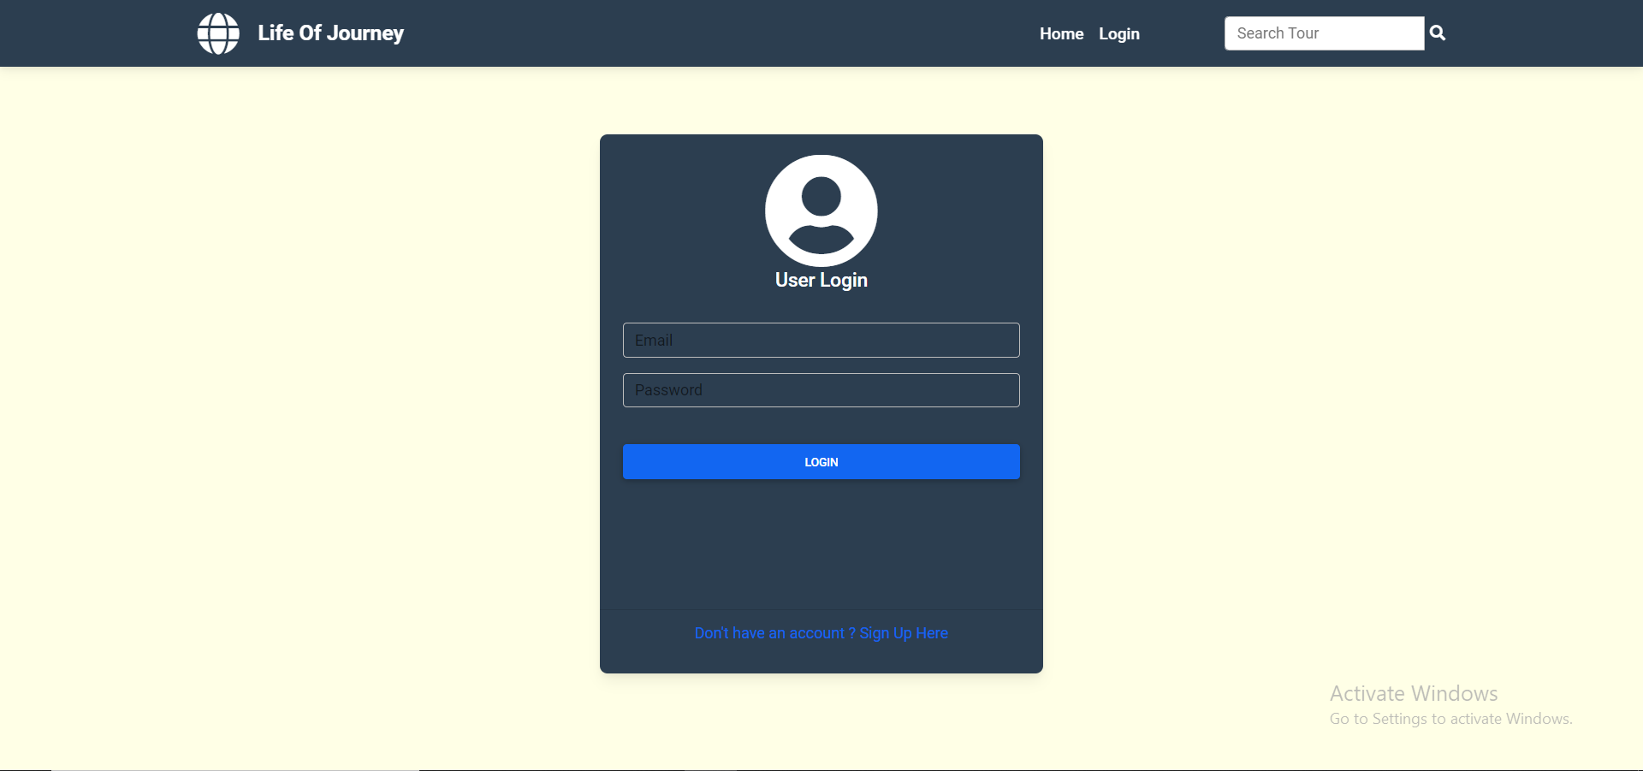

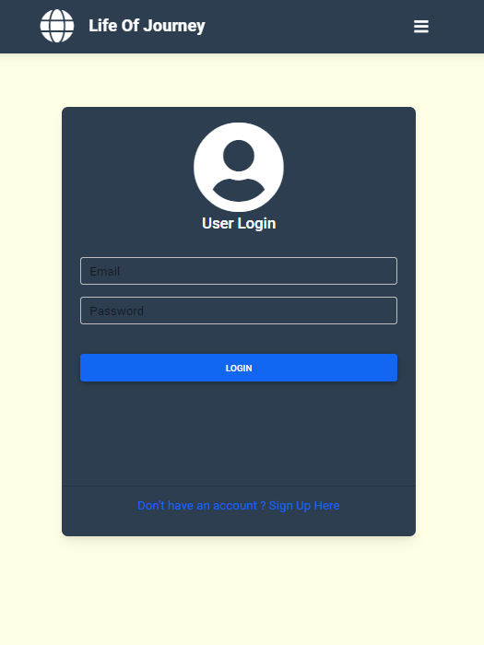
Login Page

Slide 9
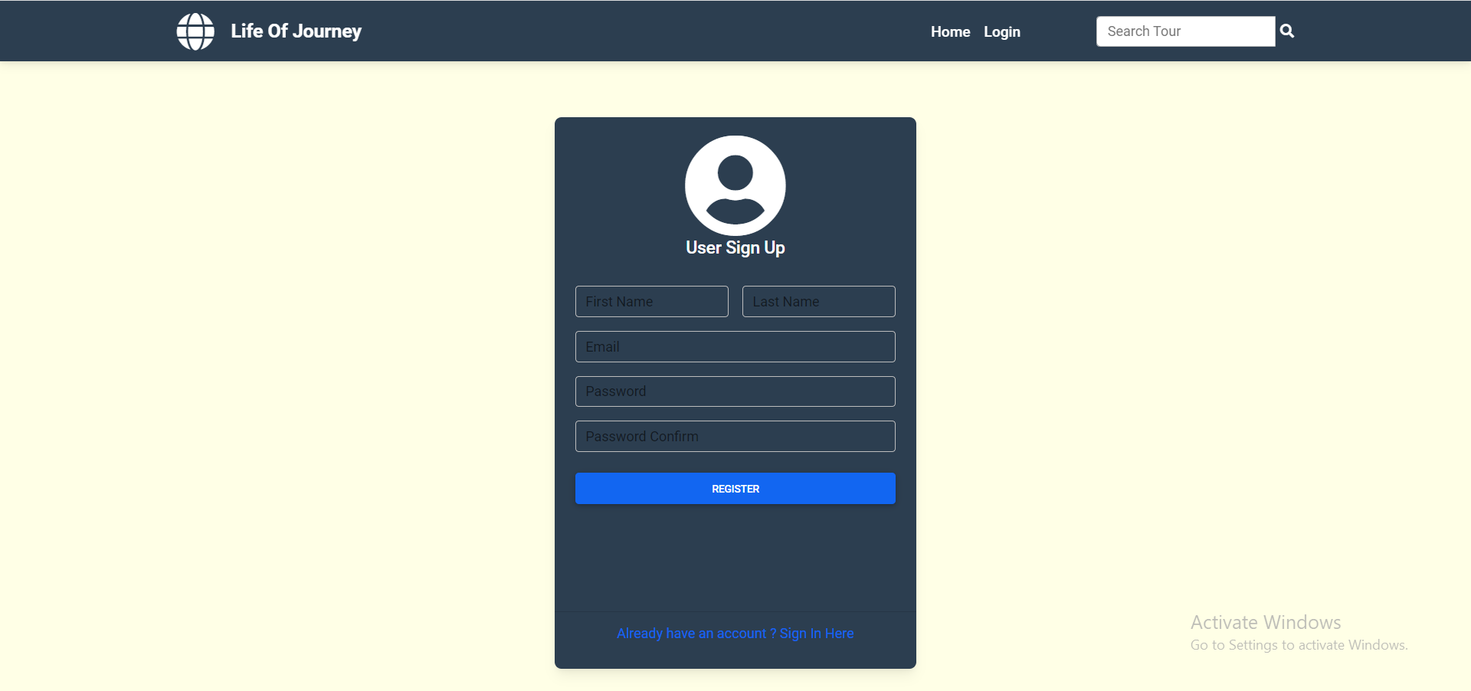
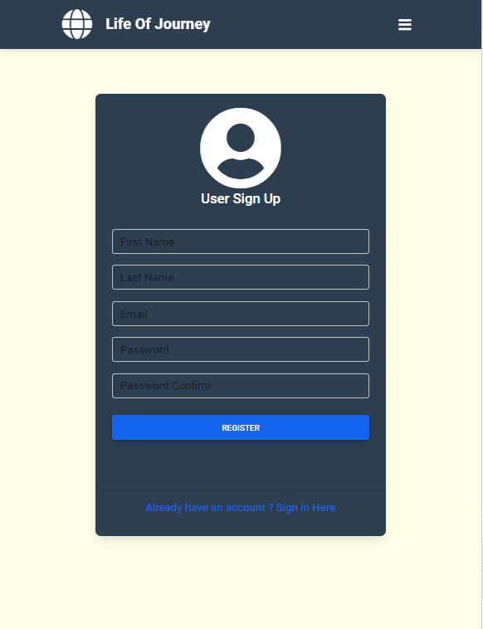
Sign Up Page

Slide 10
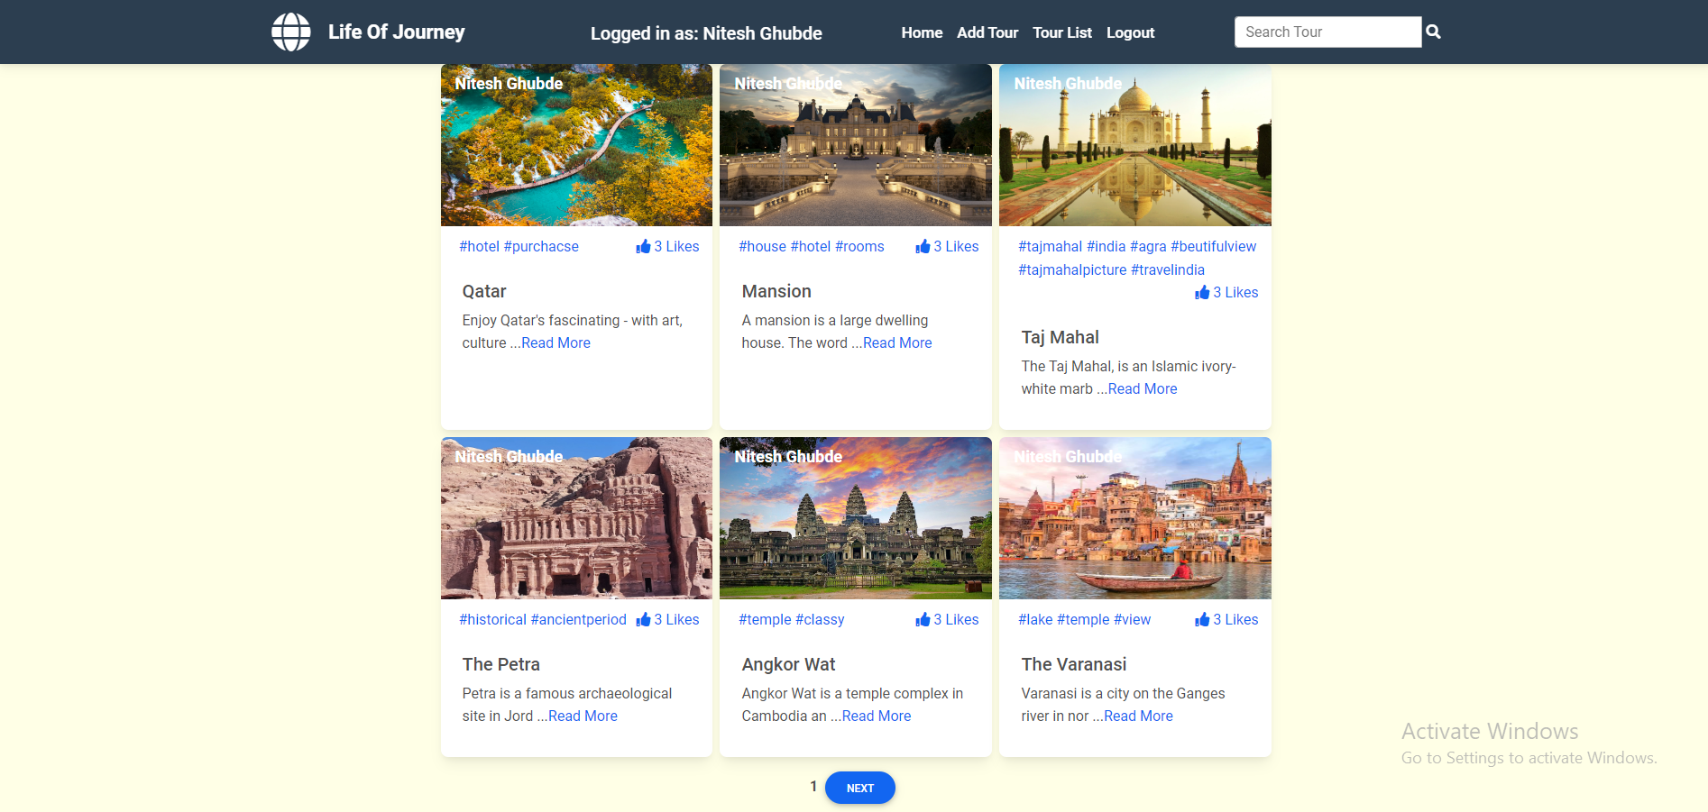
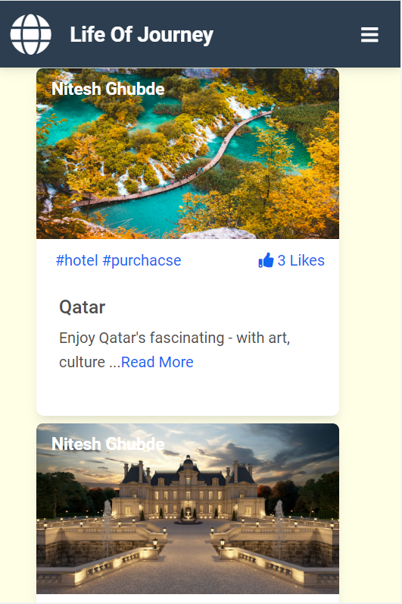
Home Page

Slide 11
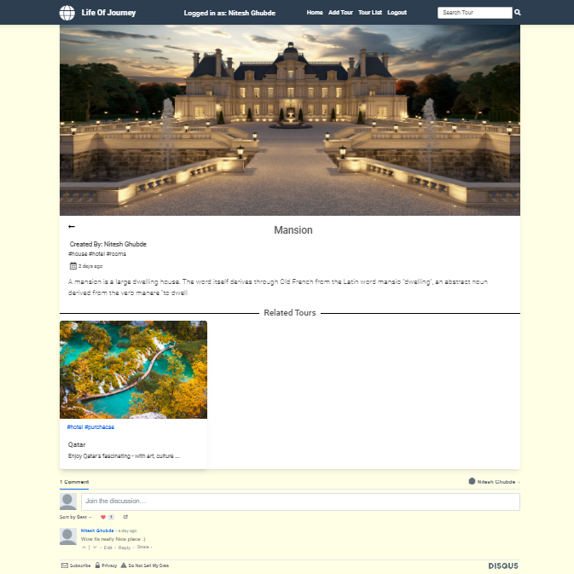
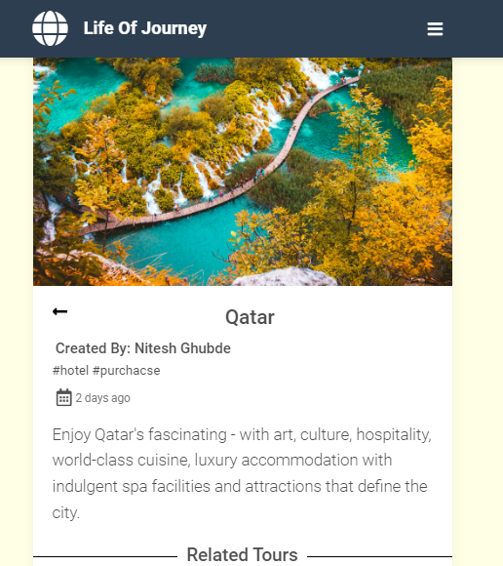
Single Tour Page

Slide 12
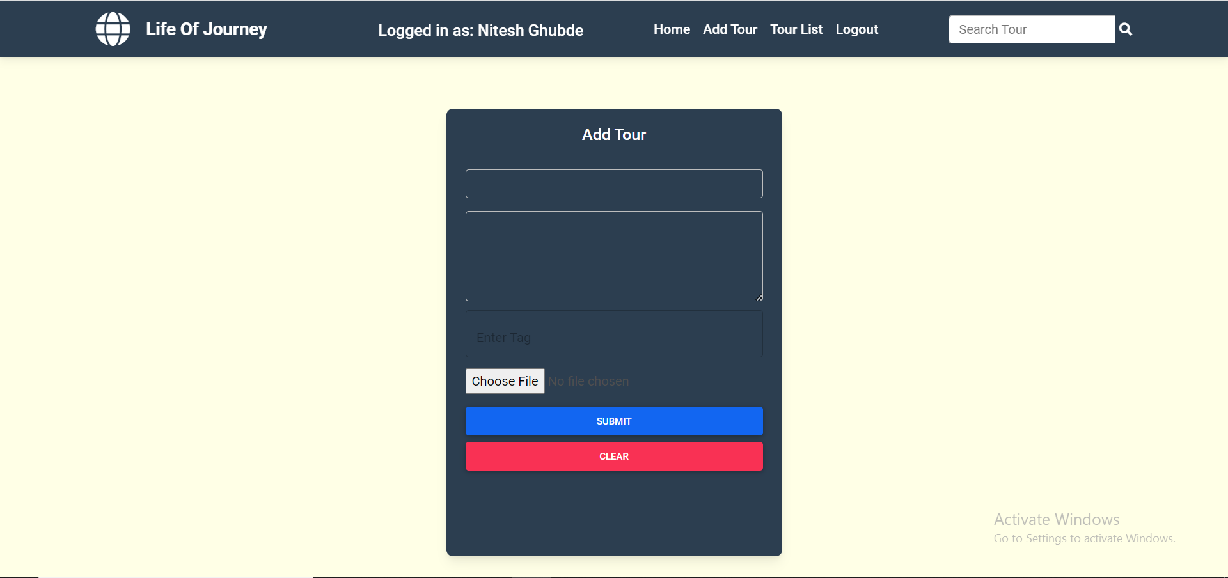
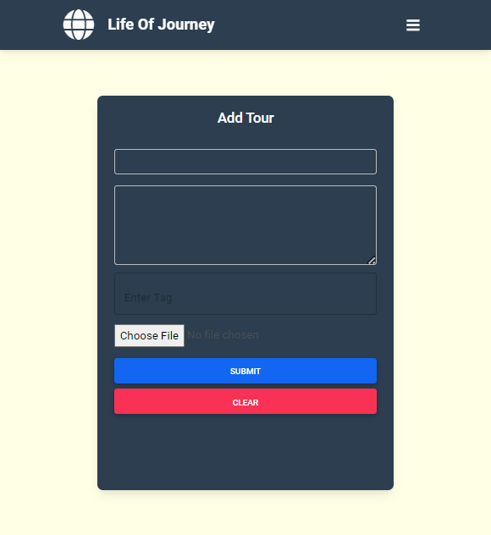
Add Tour Page

Slide 13
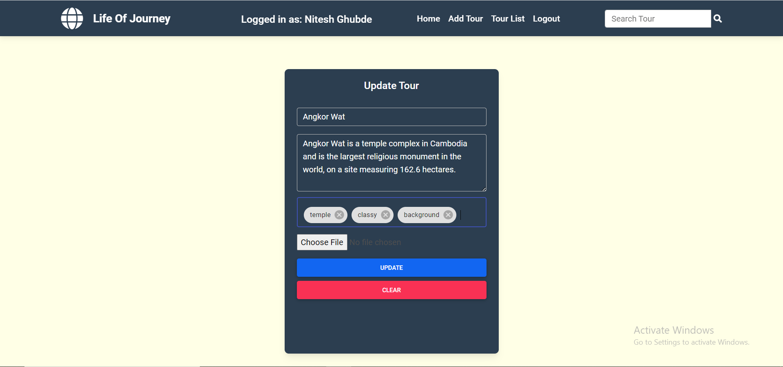
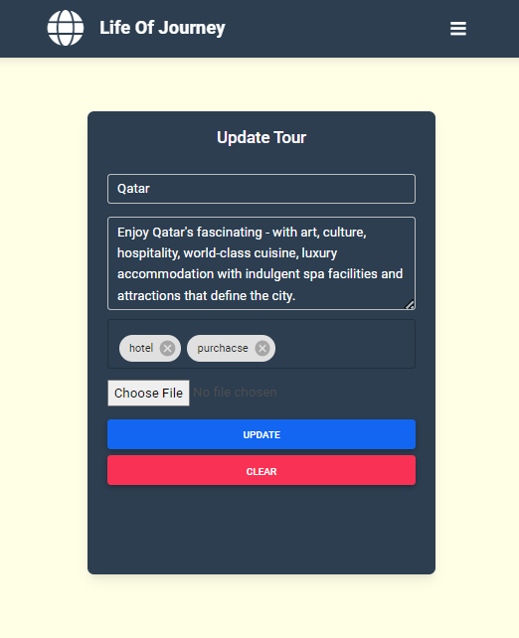
Update Tour Page

Slide 14
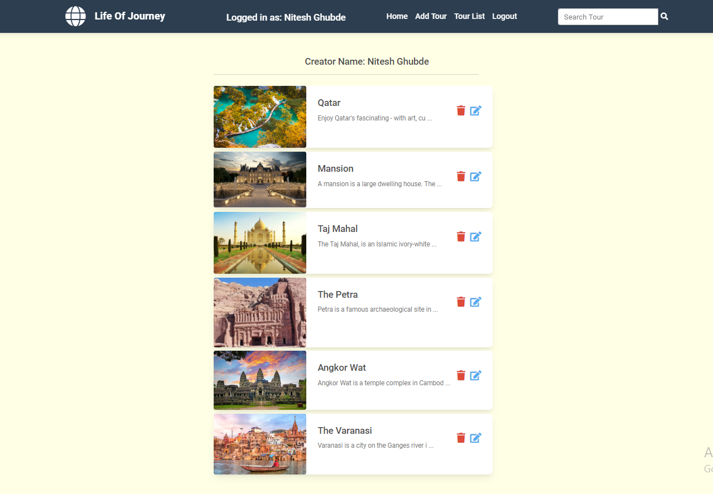
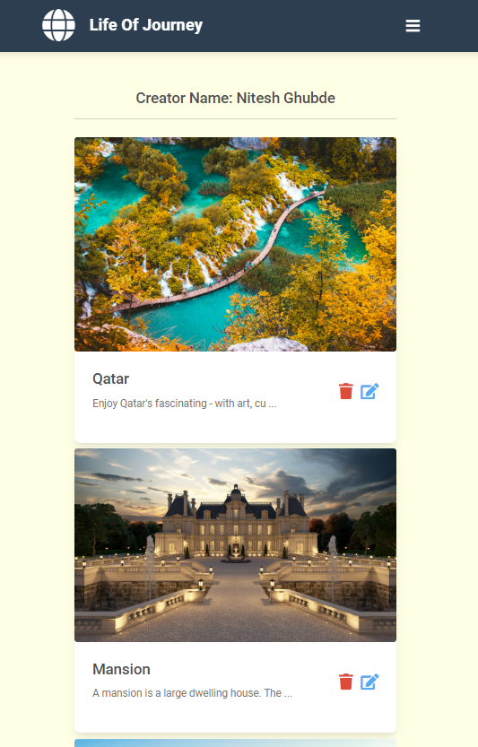
List Of Tours

Slide 15
FUTURE SCOPE
Any tourist agency can make use of it for saving customer details in database.
Tourism group can use it for managing their location, hotel, vehicles details.
This application can easily implemented under various situations.
We can add new features as and when we require.
Reusability of this application is also possible.

Slide 16
CONCLUSION
Travel and tourism management" simplifies the management process in travelling.
Fast processing and immediate results with high security.
Minimizing human effort and cost efficient databases.
Navigation through the site is easy.

Slide 17
REFERENCES
https://anintroductiontotourism.weebly.com/reference-list.html
https://en.wikipedia.org/wiki/Bibliography_of_tourism
https://libguides.lib.msu.edu/c.php?g=409278&p=2787611

Slide 18
Thank you !

